Slide 1
Computational Physics
(Lecture 8)
PHY4061

Slide 2
The Faddeev--Leverrier method
A very interesting method developed for matrix inversion and eigenvalue problem.
The scheme was first discovered by Leverrier in the middle of the nineteenth century
modified by Faddeev (Faddeev and Faddeeva, 1963).

Slide 3
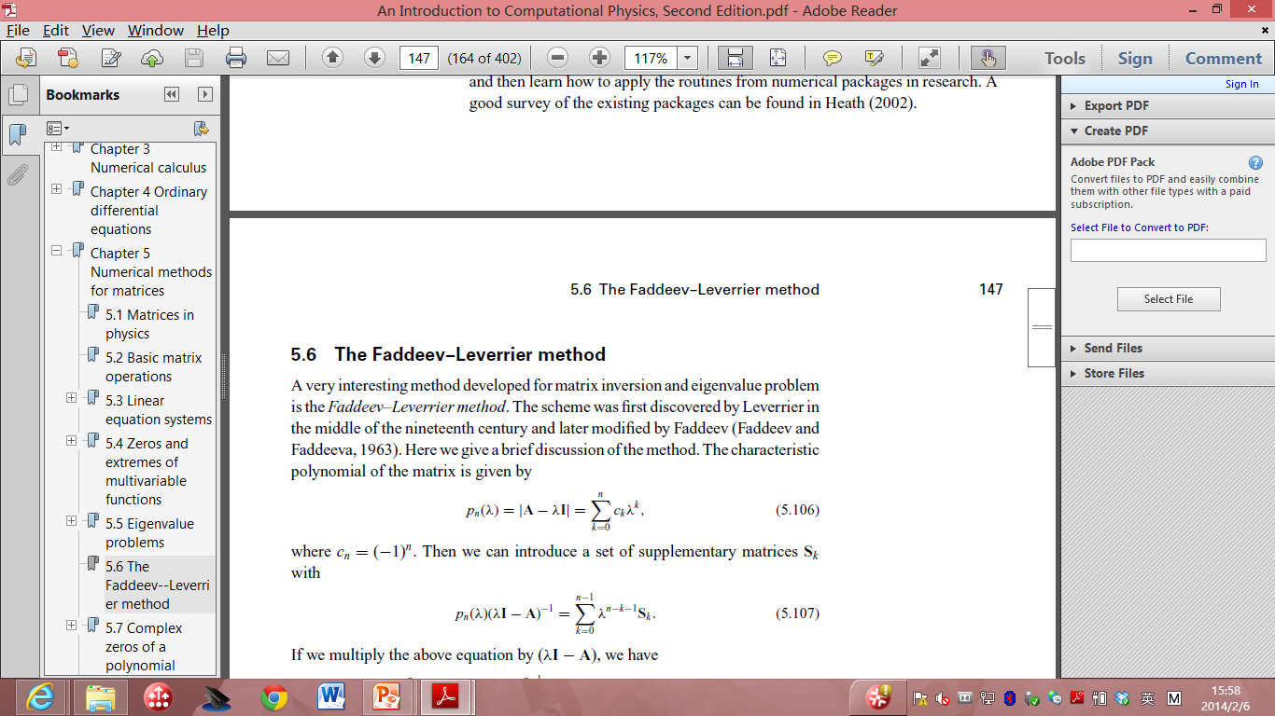

The characteristic polynomial of the matrix is given by
  where c_{n} = −1^{n}.
we can introduce a set of supplementary matrices S_{k} with

Slide 4
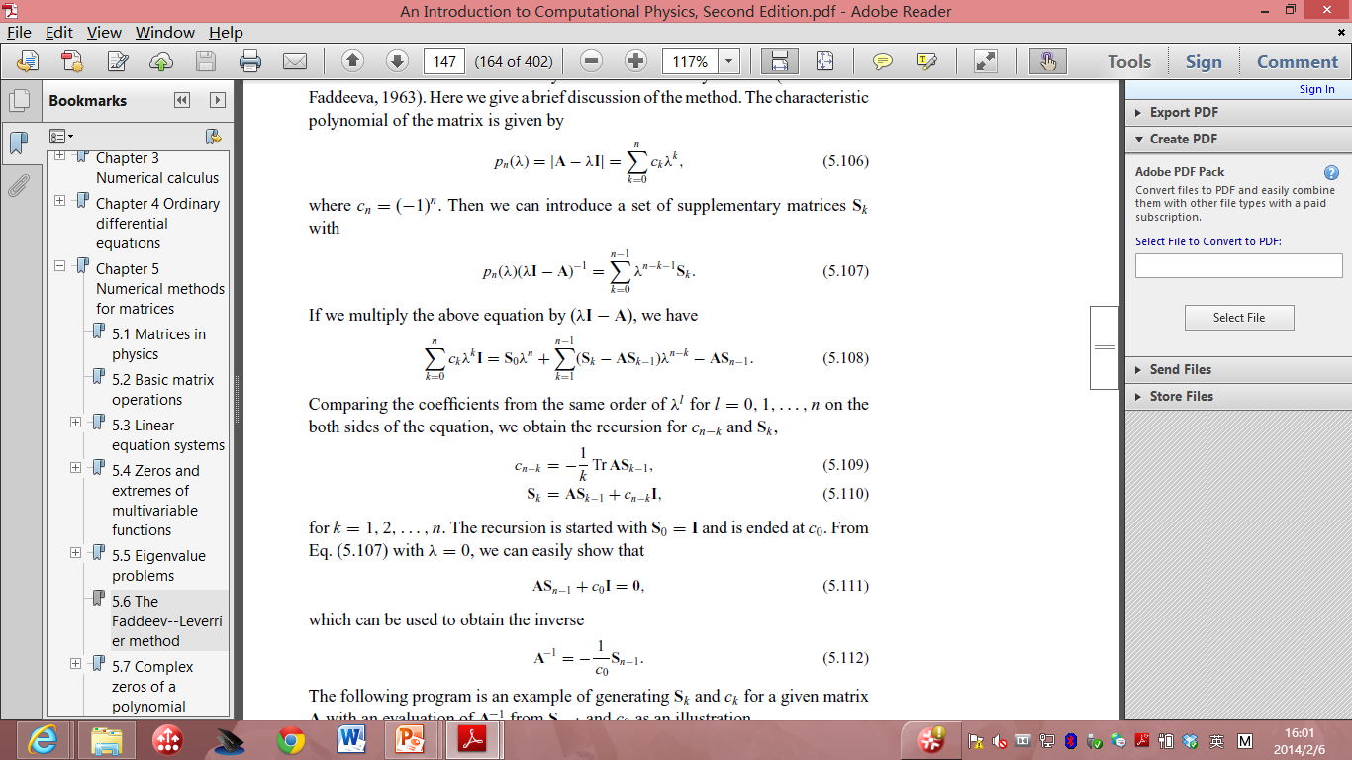
If we multiply the above equation by (λ I – A), we have:
Comparing the coefficients from the same order of λ ^{l} for l = 0, 1,…n on the both sides of the equation, we obtain the recursion:
  For k = 1, 2, …, n. The recursion is started with S₀ = I is ended at c₀.
  With λ = 0, we can show that

Slide 5
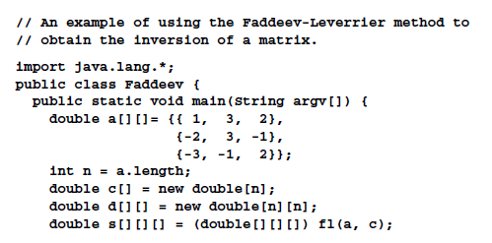
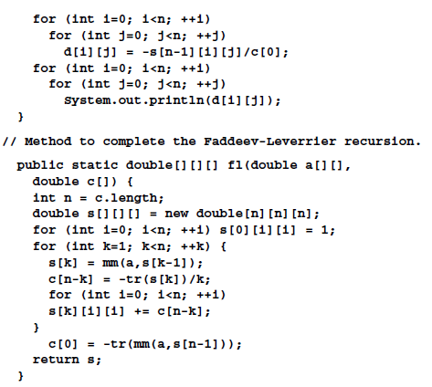
Mistake in the code!
The correct one should be
c[0] = -tr(mm(a,s[n-1]))/n;

Slide 6
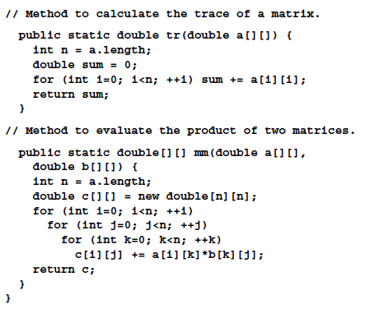

Slide 7
Because the Faddeev–Leverrier recursion also generates all the coefficients c_{k} for the characteristic polynomial p_{n}(λ),
we can use a root search method to obtain all the eigenvalues from p_{n}(λ) = 0.

Slide 8
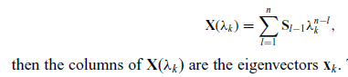
After we have found all the eigenvalues λ_{k} , we can also obtain the corresponding eigenvectors with the availability of the supplementary matrices S_{k}.

Slide 9
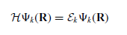

Electronic structures of atoms
The Schrodinger equation for a multi-electron atom is given by

Slide 10
Hartree Fock Approximations
The Born–Oppenheimer approximation is inherently assumed.
Typically, relativistic effects are completely neglected.
The variational solution is assumed to be a linear combination of a finite number of basis functions.
Each energy eigenfunction is assumed to be describable by a single Slater determinant
The mean field approximation is implied. Effects arising from deviations from this assumption, known as electron correlation, are completely neglected for the electrons of opposite spin, but are taken into account for electrons of parallel spin.

Slide 11
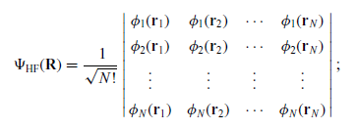
the ground state is approximated by the Hartree–Fock ansatz, which can be cast into a determinant

Slide 12
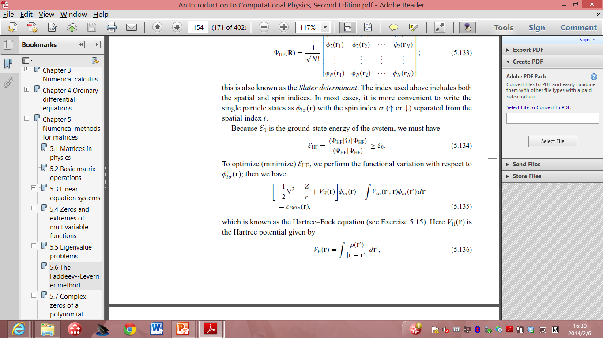
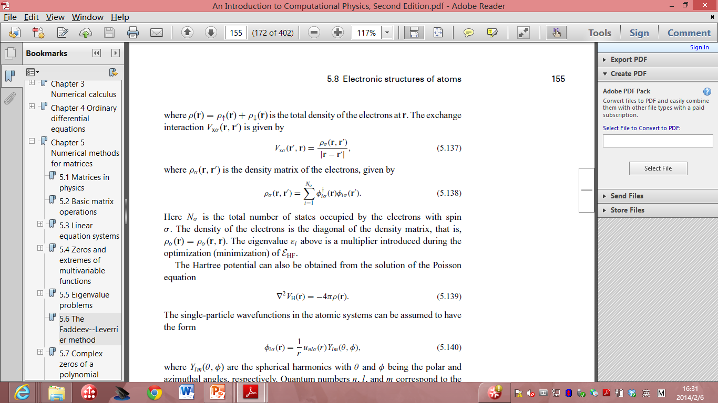
To optimize (minimize) E_{HF}, we can perform the functional variation with respect to
  Hartree-Fock equation.
  V_{H}(R) (HF potential) is given by:
  Where: is the total density of the electron at r.
  The exchange correlation is given by:

Slide 13
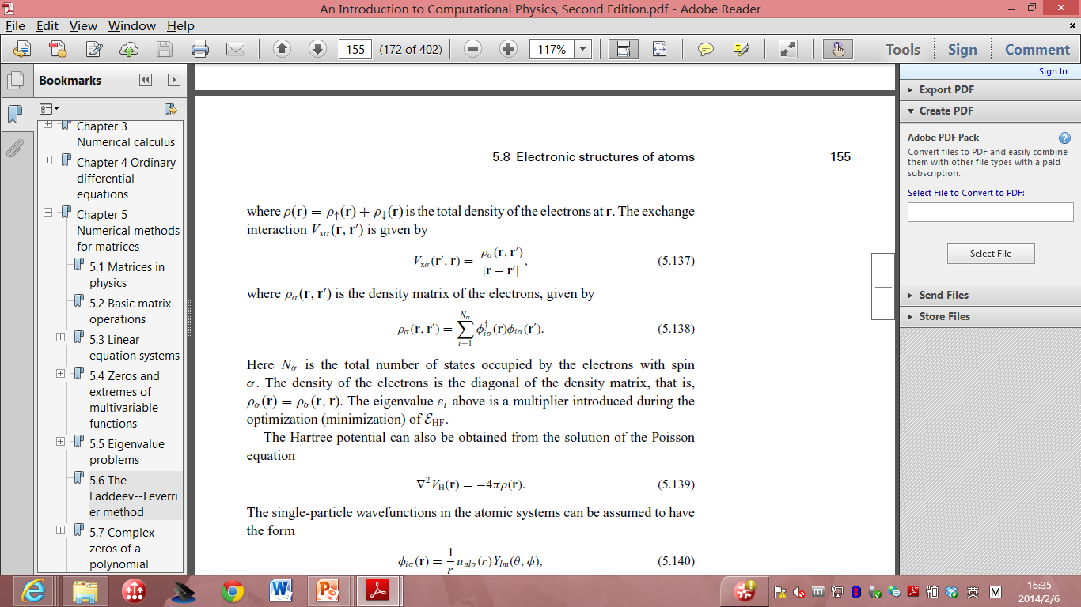
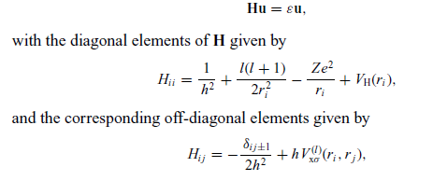
The Hartree potential can also be obtained from the solution of the Poisson equation:
The single particle wavefunctions in the atomic systems can be assumed to have the form:
The H-F equation for given i can be further converted into:

Slide 14
We can easily apply the numerical schemes introduced in this lecture to solve this matrix eigenvalue problem.

Slide 15
Inverse of a matrix
What’s the most straightforward way to inverse a matrix?

Slide 16
Inverse of a matrix
The inverse of a matrix A using linear equating approach: A⁻¹ _{i j} = x_{i j} ,
  for i, j = 1, 2, . . . , n,
    where x_{i j} is the solution of the equation Ax_{j} = b_{j} , with b_{i j} = δ_{i j} .
If we expand b into a unit matrix in the program for solving a linear equation set,
  the solution corresponding to each column of the unit matrix forms the corresponding column of A⁻¹

Slide 17
// An example of performing matrix inversion through the
// partial-pivoting Gaussian elimination.
import java.lang.*;
public class Inverse {
public static void main(String argv[]) {
double a[][]= {{ 100, 100, 100},
{-100, 300, -100},
{-100, -100, 300}};
int n = a.length;
double d[][] = invert(a);
for (int i=0; i<n; ++i)
for (int j=0; j<n; ++j)
System.out.println(d[i][j]);
}
public static double[][] invert(double a[][]) {
int n = a.length;
double x[][] = new double[n][n];
double b[][] = new double[n][n];
int index[] = new int[n];
for (int i=0; i<n-1; ++i)
for (int j=i+1; j<n; ++j)
for (int k=0; k<n; ++k)
b[index[j]][k]
-= a[index[j]][i]*b[index[i]][k];
// Perform backward substitutions
for (int i=0; i<n; ++i) {
x[n-1][i] = b[index[n-1]][i]/a[index[n-1]][n-1];
for (int j=n-2; j>=0; --j) {
x[j][i] = b[index[j]][i];
for (int k=j+1; k<n; ++k) {
x[j][i] -= a[index[j]][k]*x[k][i];
}
x[j][i] /= a[index[j]][j];
}
}
return x;
}
public static void gaussian(double a[][], int index[])
{...}
}
for (int i=0; i<n; ++i) b[i][i] = 1;
// Transform the matrix into an upper triangle
gaussian(a, index);
// Update the matrix b[i][j] with the ratios stored

Slide 18
LU decomposition
A scheme related to the Gaussian elimination is called LU decomposition,
  which splits a nonsingular matrix into the product of a lower-triangular and an upper-triangular matrix.
the Gaussian elimination corresponds to
  a set of n − 1 matrix operations that can be represented by a matrix multiplication
  A^{n−1} = MA,
  where
  M = M^{n−1}M^{n−2} · · ·M¹,
  with each M^{r}, for r = 1, 2, . . . , n − 1, completing one step of the elimination.

Slide 19
It s easy to show that M is a lower-triangular matrix with all the diagonal elements being −1 and M^{k}_{i j} = −A ^{j−1}_{k_i j} /A ^{j−1}_{k_ j j} for i > j .
So A = LU, where U = A^{n−1} is an upper-triangular matrix and L = M⁻¹ is a lower-triangular matrix.

Slide 20
Furthermore, because M_{ii} = −1, we must have L_{ii} = 1 and L_{i j} = −M_{i j} = A ^{j−1}_{ki j} /A ^{j−1}_{k j j} for i > j ,
  which are the ratios stored in the matrix in the method introduced earlier in this section to perform the partial-pivoting Gaussian elimination.

Slide 21
The method performs the LU decomposition with nonzero elements of U and nonzero, nondiagonal elements of L stored in the returned matrix.
The choice of L_{ii} = 1 in the LU decomposition is called the Doolittle factorization.
An alternative is to choose U_{ii} = 1; this is called the Crout factorization.
  The Crout factorization is equivalent to rescaling U_{i j} by U_{ii} for i < j and multipling L_{i j} by U_{j j} for i > j from the Doolittle factorization.

Slide 22
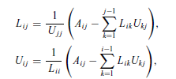
In general the elements in L and U can be obtained from comparison of the elements of the product of L and U with the elements of A.
The result can be cast into a recursion with
where L_i1 = A_i1/U_11 and U_1 j = A_1 j /L11 are the starting values.

Slide 23
We can apply the same pivoting technique and store the L and U values at the zero component of the matrix.
The determinant of A is given by the product of the diagonal elements of L and U because |A| = |L||U|

Slide 24
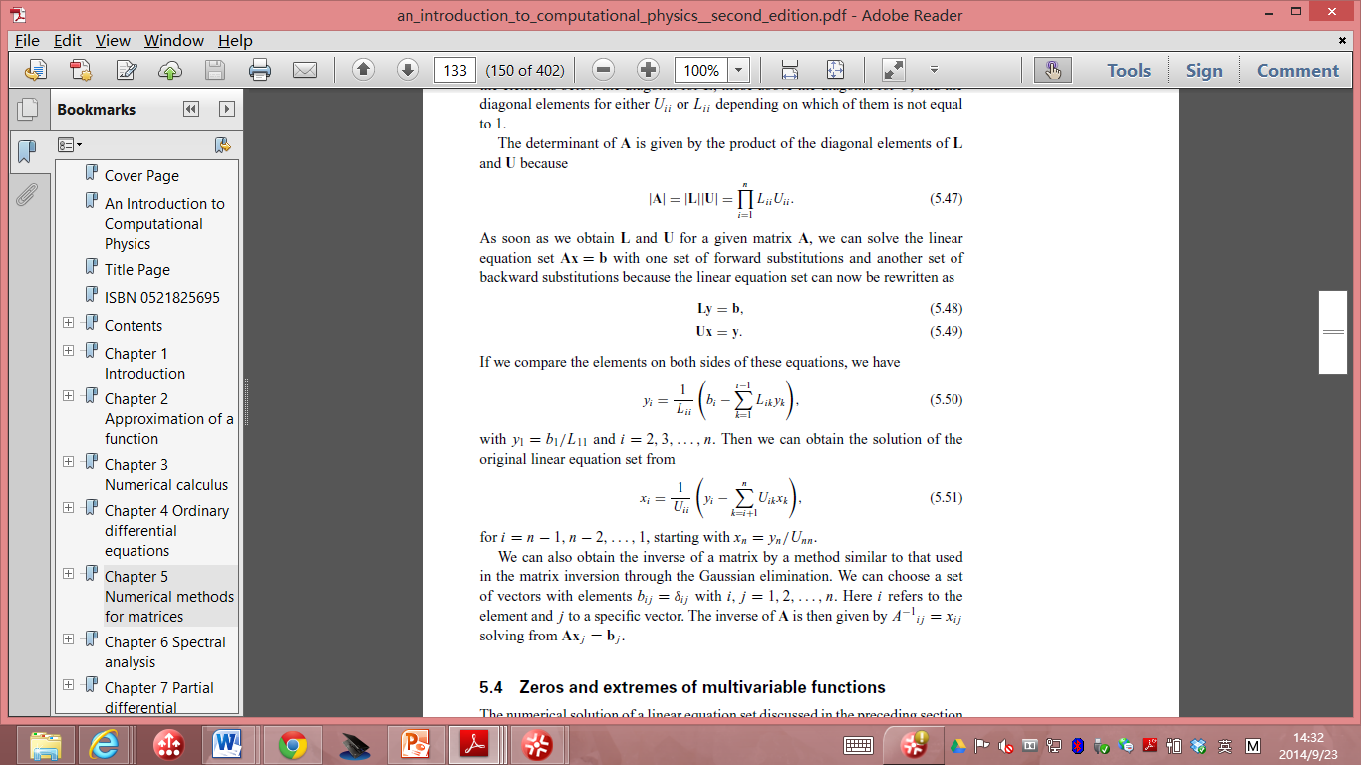
As soon as we obtain L and U for a given matrix A, we can solve the linear equation set Ax = b with one set of forward substitutions and another set of backward substitutions
  the linear equation set can now be rewritten as
    Ly = b, Ux = y.
If we compare the elements on both sides of these equations, we have
  with y₁ = b₁/L₁₁ and i = 2, 3, . . . , n.

Slide 25
We can obtain the solution of the original linear equation set from
for i = n − 1, n − 2, . . . , 1, starting with x_n = y_n/U_nn.

Slide 26
More on ionic potential

Slide 27
As r increases, the number of interactions rises in proportion to the surface area of the cut-off sphere: N_{r} ∝ 4πr ² .
However, the interaction itself only decreases as the inverse power of r
Consequently, the magnitude of interaction potentially increases as the cut-off radius is extended.
The fact that the magnitude converges in practice relies on the fact that there is cancelation between interactions with cations and anions.

Slide 28
It turns out that the electrostatic energy of a system actually depends on the macroscopic state of a crystal due to the long-ranged effect of Coulomb fields.
It is not purely a property of the bulk crystal, but also depends, in general, on the nature of the surfaces and of the crystal morphology.
To make it feasible to define an electrostatic energy that is useful for the simulation of ionic materials, it is conventional to impose two conditions on the Coulomb summation:

Slide 29
The sum of the charges within the system must be equal to zero
The total dipole moment of the system in all directions must also be equal to zero
If these conditions are satisfied, the electrostatic energy will always converge to the same value as the cut-off radius is incremented.

Slide 30
There is also the issue of how rapidly the sum converges,
  since it is required that the calculation be fast for numerical evaluation.
By far the dominant approach to evaluating the electrostatic energy is through the use of the summation method due to Ewald
  which aims to accelerate the convergence by partially transforming the expression into reciprocal space.
The details of the derivation can be found in Kittel’s textbook on solid state physics.
Here I just listed the basic idea of Ewald summation.
  Do not worry, I do not require you to implement Eward summation.

Slide 31
In Ewald’s approach, a Gaussian charge distribution of equal magnitude, but opposite sign, is placed at the position of every ion in the crystal.
Because the charges cancel, all but for the contribution from the differing shape of the distribution,
the resulting electrostatic interaction between ions is now rapidly convergent when summed out in real space and converges to the energy U_{real}.
In order to recover the original electrostatic energy it is then necessary to compute two further terms.

Slide 32
Firstly, the interaction of the Gaussian charge distributions with each other must be subtracted.
Because of the smooth nature of the electrostatic potential arising from such a distribution, it is possible to efficiently evaluate this term, Urecip, by expanding the charge density in plane waves with the periodicity of the reciprocal lattice.
Again, the energy contribution is rapidly convergent with respect to the cut-off radius within reciprocal space.
Finally, there is the self-energy, Uself, that arises from the interaction of the Gaussian with itself.

Slide 33
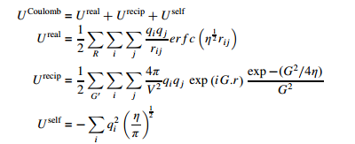
Mathematically, the Ewald sum is derived by a Laplace transform of the Coulomb energy and the final expressions are given below;

Slide 34
where R denotes a real space lattice vector, G represents a reciprocal lattice vector and η is a parameter that determines the width of the Gaussian charge distribution.
Note that the summation over reciprocal lattice vectors excludes the case when G = 0.

Slide 35
The key to rapid convergence of the Ewald sum is to choose the optimal value of η.
If the value is small, then the Gaussians are narrow and so the real space expression converges quickly, while the reciprocal space sum requires a more extensive summation due to the higher degree of curvature of the charge density.
Choosing a large value of η obviously leads to the inverse situation.

Slide 36
One approach to choosing the convergence parameter is to derive an expression for the total number of terms to be evaluated in real and reciprocal space for a given accuracy and then to find the stationary point where this quantity is at a minimum.
The choice of η_{opt} is then given by; η_{opt} = (Nπ³ /V) ^{1/3} where N is the number of particles within the unit cell.

Slide 37
While the electrostatic energy often accounts for the majority of the binding,
the non-Coulombic contributions are equally critical since they determine the position and shape of the energy minimum.
There must always be a short-ranged repulsive force between ions to counter the Coulomb attraction and therefore prevent the collapse of the solid.

Slide 38
Most work has followed the pioneering work in the field, as embodied in the Born– Meyer and Born–Lande equations for the lattice energy, by utilizing either an exponential or inverse power-law repulsive term.
This gives rise to two widely employed functional forms, namely the Buckingham potential; U_{short−ranged ij} = A_{ij} exp (− r_{ij} /ρ_{ij} ) − Cij / r⁶ _{ij} and that due to Lennard–Jones: U_{short−ranged ij} = B_{ij} /r^{m} _{ij} − C_{ij} /r ^{n} _{ij}

Slide 40
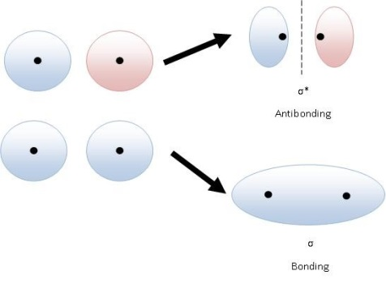
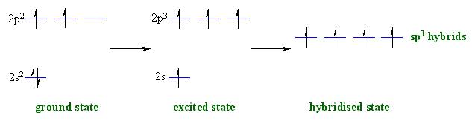
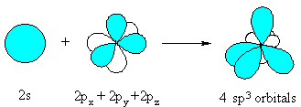
An Overview on Inter-atomic Potentials (CONTINUED)
Covalently bonded Solids: Semiconductors
Bonding and Antibonding

Slide 41
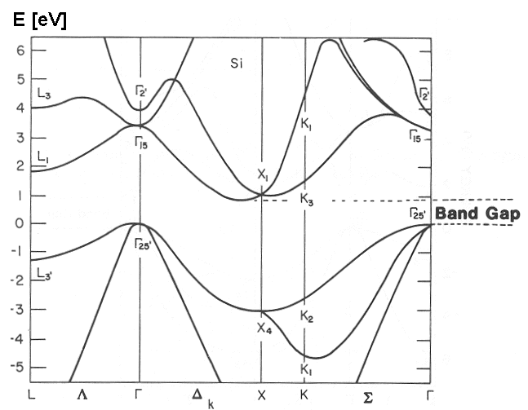
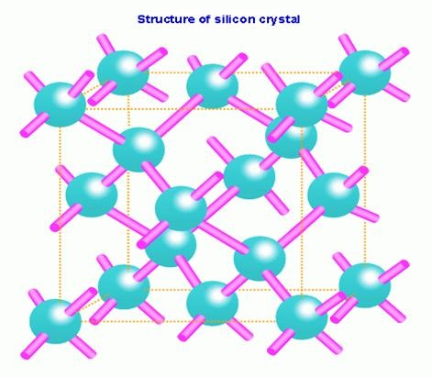
Silicon
  studied extensively
  important for the semiconductor industry.
forms bonds with the nearest 4 atoms with a local tetrahedron structure.
unlikely to ever come out of a pair potential
A higher order many-body terms has to be included in the potential!

Slide 42
One well-known potential function for silicon is the Stillinger-Weber potential
  Phys. Rev. B 31, 5262 (1985).
SW contains an explicit term
  forces the angle between the bonds of nearby atoms to stay close to 109 degrees and has been adjusted to giving roughly the lattice constant, the cohesive energy, the melting point and liquid structure.

Slide 44
Another popular potential function for Si (as well as Ge and C) is the Tersoff potential [Phys. Rev. B 39, 5566 (1989).]
  a review article Balamane, Phys. Rev. B, 40, 2250 (1992) describing how well various potentials work on silicon.
  the potentials, even if they have been carefully tuned, do not really describe all aspects of pure silicon terribly well.
  Car-Parrinello technique is viewed as an advance (even though it is slow). One gets a better (but still not perfect) potential, without having to adjust lots of parameters.
  Tight-binding potentials are another possible semi-empirical functional forms for treating semiconductors.

Slide 45
Metals
How about the metals?
Metals are characterized by a rare gas shell plus a number of valence electrons.
Pair potentials do not work terribly well because the electrons are very much delocalized.
If one does use a pair potential, it must be softer than the Lennard-Jones form, for example a Morse potential (sum of exponentials.)
The major problem with pair potentials for solid metals is that they have no environmental dependence so that a bulk atom is too much like a surface atom.

Slide 46
One popular empirical potential for metals is the embedded-atom-method (EAM) potential. It is based on the basic idea of jellium model that “metallic bonding” involves ions in an electron sea (jellium)
  so the total potential energy
    is the sum of direct ion-ion interaction (for example to keep to ion cores from overlapping) and the interaction between an ion and the electron sea.
One assumes that locally there is an electron charge density coming from the nearby ions and that the energy and interaction are some function of this density.
This later term is then a true many-body potential.
The EAM potential works well for spherically symmetric atoms such as Cu, Al, Pb. Some references are Daw and Baskes, Phys. Rev. B 29, 6443 (1984) and Foiles, Baskes and Daw, Phys. Rev. B 33, 7983 (1986).
Tight-binding potentials are another possible functional forms for treating metals, especially for transition-metal solids.

Slide 47
Metal: EAM potential:

Slide 48
Biomolecular Sytems
For other systems there are extensive codes which handle real biomolecular systems (GROMOS, CHARM, AMBER ...) They use an experimental data base and put in specific terms for bond lengths, bond angles, torsion angles. etc.
complicated because they have to distinguish between many local bonding arrangements!
Even so, one should never fully trust the accuracy of the empirical potentials.
The errors can still be quite large even if a lot of data has been put in. This is because the potential surface is so highly dimensional and there are so many different possible combinations of atoms that experiment can only hope to sample a very few of them.

